Slide 1




Comparative analysis of neural methods for entity normalization in the biological field
Soutenance de stage - M1 bioinformatique
Antoine Toffano
Encadrants : Arnaud Ferré | Louise Deléger

Slide 2

Introduction
Context: Information extraction
Entity detection
Bacteria
Habitat
“E. Coli and L. Lactis. are anaerobic bacterium that are commonly found in the lower-intestine of humans”

Slide 3
Introduction
Context: Information extraction
Entity normalization
NCBI:562
Label: Escherichia Coli
NCBI:1246
Label: Lactococcus Lactis
OBT:002810
Label : intestine
OBT:002488
Label: human
Bacteria
Habitat
“E. Coli and L. Lactis. are anaerobic bacterium that are commonly found in the lower-intestine of humans”

Slide 4
Introduction
Context: Information extraction
Ontology of bacterial habitats
OBT:00010
is_a
OBT:00001
is_a
“living organism“
“microbial habitat”
is_a
OBT:02488
OBT:00014
“part of living organism”
“human”
is_a
is_a
is_a
OBT:03188
OBT:03245
OBT:02810
“child”
“adult human”
“intestine”

Slide 5
Introduction
Context: Information extraction
Bacteria
Habitat
“E. Coli and L. Lactis. are anaerobic bacterium that are commonly found in the lower-intestine of humans”
Mention | Normalization
 | Label(s) | CUI
“E.coli” | “Escherichia Coli” | NCBI:562
“L.Lactis” | “Lactococcus Lactis” | NCBI:1246
“lower-intestine” | “Intestine” / “gut” | OBT:02810
“human” | “Human” | OBT:02488

Slide 6
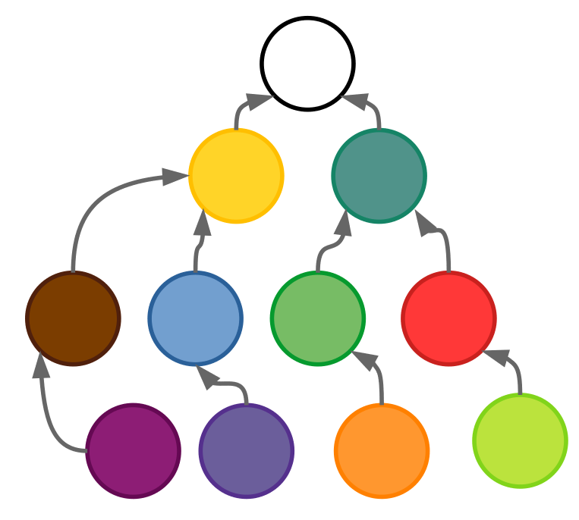
Methodology
Form matching
“intestine”
“skin”
“mouth”
“water”
…
“soil”
ID150
ID151
ID154
ID158
...
ID432
“intestine”

Slide 7
Methodology
Form matching
“intestine”
“skin”
“mouth”
“water”
…
“soil”
ID150
ID151
ID154
ID158
...
ID432
“intestine”

Slide 8
Methodology
Form matching
“intestine”
“skin”
“mouth”
“water”
…
“soil”
ID150
ID151
ID154
ID158
...
ID432
“intestine”
“the lower intestine”

Slide 9
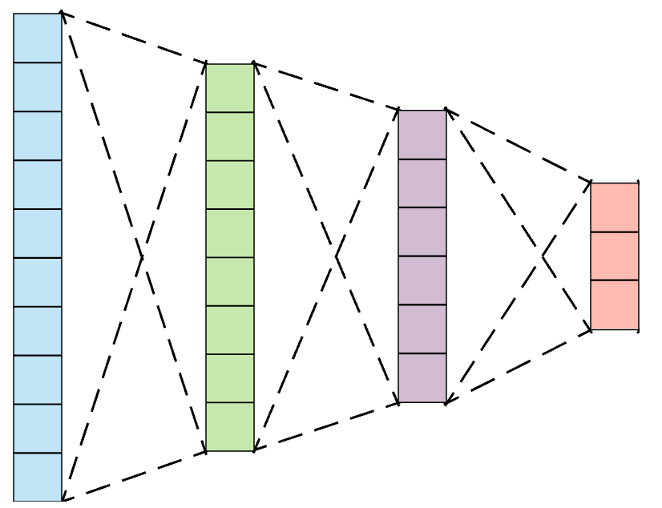
Methodology
Vectorization
“intestine”
“skin”
“mouth”
“water”
…
“soil”
ID150
ID151
ID154
ID158
...
ID432
“intestine”
“the lower intestine”

Slide 10
Methodology
Vectorization
“intestine”
“skin”
“mouth”
“water”
…
“soil”
ID150
ID151
ID154
ID158
...
ID432
“intestine”
“the lower intestine”

Slide 11
Methodology
Vectorization
“intestine”
“skin”
“mouth”
“water”
…
“soil”
ID150
ID151
ID154
ID158
...
ID432
“intestine”
“the lower intestine”
“gut”

Slide 12
Methodology
Vectorization
Distributional hypothesis
Two words sharing a context share the same meaning
 | E.coli | in | the | gut | of | humans
E.coli | 0 | 2 | 2 | 1 | 2 | 2
in | 2 | 0 | 2 | 1 | 2 | 2
the | 2 | 2 | 0 | 1 | 2 | 2
intestine | 1 | 1 | 1 | 0 | 1 | 1
of | 2 | 2 | 2 | 1 | 0 | 2
humans | 2 | 2 | 2 | 1 | 2 | 0

Slide 13
Methodology
Machine learning
Compressed representation
BioBERT
Word2Vec

Slide 14

Methodology
Machine learning
Mention
“gut”
Score
ID150
ID151
ID154
ID158
...
ID432
“intestine”
“skin”
“mouth”
“water”
…
“soil”
“water”
Candidate

Slide 15

Objectives
Comparing methods on different datasets
BioSyn
BioBERT
NCBI disease
Lightweight
Word2Vec
Bacteria biotope
?
Phenotype Habitat

Slide 16
Objectives
Comparing methods on different datasets
Bacteria
Biotope 4
BioSyn
Bacteria
Biotope 4
NCBI Disease
Lightweight
NCBI Disease
Standardize
Adapt

Slide 17
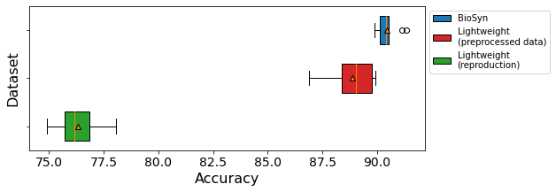
Results
Reproduction
NCBI disease
BioSyn : 91.10 accuracy on NCBI Disease
Lightweight : 89.59 accuracy on NCBI Disease

Slide 18
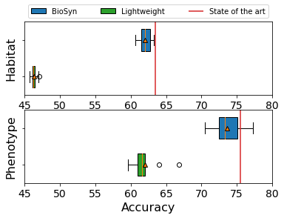
Results
Adaptation to Bacteria Biotope

Slide 19
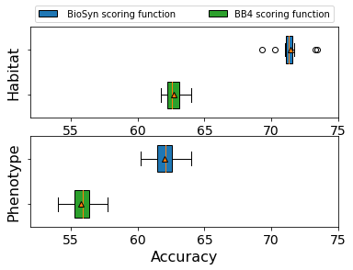
Discussion
Scoring methods
BioSyn

Slide 20
Thank you for your attention!

